Slide 1
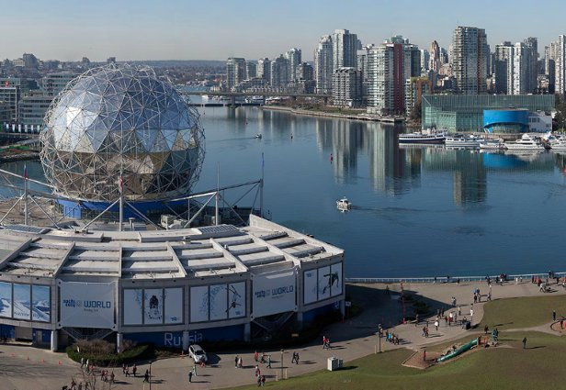
The Future of the Workplace
Angela Cain, CEO
CoreNet Global

Slide 2
THE FUTURE OF THE WORKPLACE
Corporate Real Estate 2020
Drivers for Workplace Transformation
Workplace team research findings
Technology and the Workplace
CoreNet Global Workplace Transformation
2
Notes:
These are the 5 topic areas for the presentation

Slide 3
280 members
150 interviews
6 languages
1 goal
Notes:
Corporate Real Estate 2020 began in August 2011 and continued through May 2012. The program was launched at the AT&T headquarters in Dallas, where a group of more than 70 senior thought leaders convened to discuss the business environment in the year 2020 and create an overall vision of the future and what the impact on CRE will be. From this discussion, it was concluded that the research would be carried out by breaking down the profession into eight dimensions unique to CRE. The teams developed a set of Bold Statements, or predictions about the future of Corporate Real Estate and tested these theories through interviews, surveys and Summit breakout sessions, ending at the San Diego Summit in early May where teams reported the findings. (the next slides list the 8 teams)

Slide 4
Enterprise Leadership

Slide 5
Location Strategy and the Role of Place

Slide 6
Partnering with Key Support Functions

Slide 7
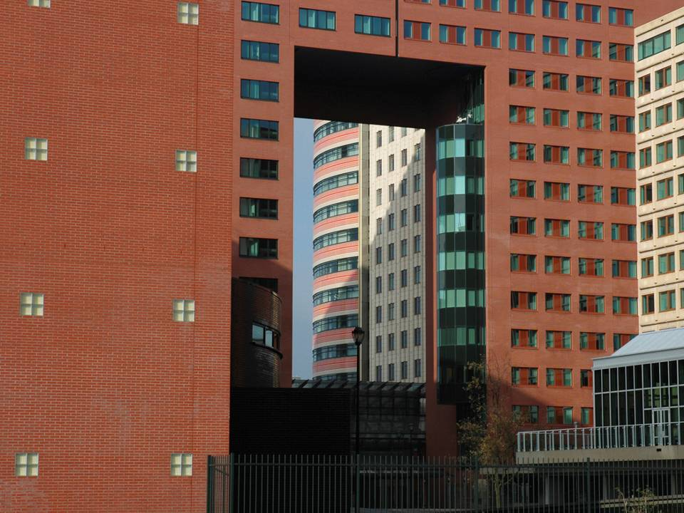
Portfolio Optimization

Slide 8
Service Delivery and Outsourcing

Slide 9
Sustainability

Slide 10
Technology
Notes:
and

Slide 11
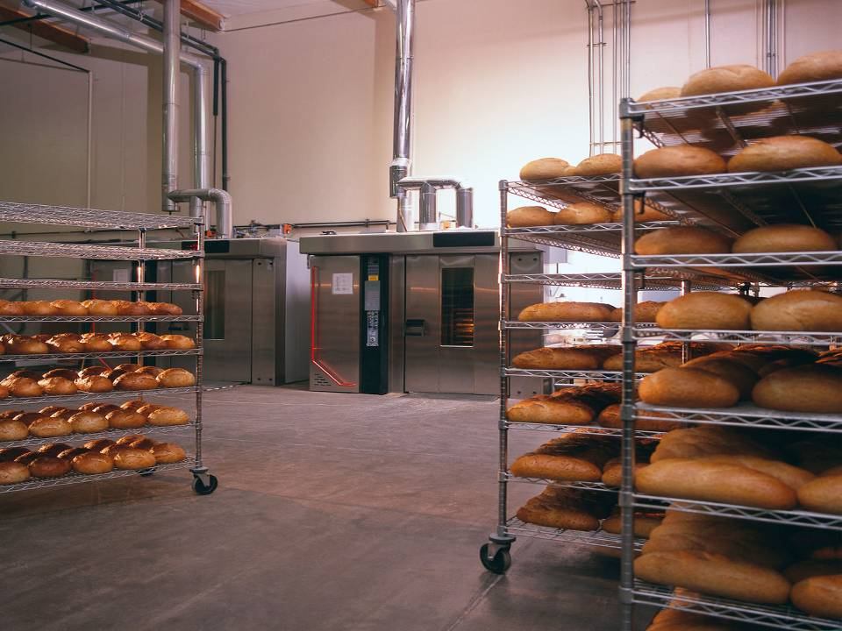
Workplace

Slide 12
2. DRIVERS FOR WORKPLACE TRANSFORMATION
Notes:
The second item in the list on slide 2 – Drivers for Workplace Transformation. The research for 2020 uncovered the following drivers behind workplace transformation

Slide 13
Cost efficiency has to be met with growth, productivity, collaboration and other forms of effectiveness
Notes:
Virtually all of CoreNet Global’s 7,000 members are faced with the continuous mandate to reduce costs and space
The drive for cost efficiency has to be met with the need for growth, productivity, collaboration and other forms of effectiveness

Slide 14
Sustainability:
use less energy and reduce carbon footprint
Notes:
Expectations for organizations to become more sustainable, use less energy and reduce their carbon footprints are more pronounced than ever

Slide 15
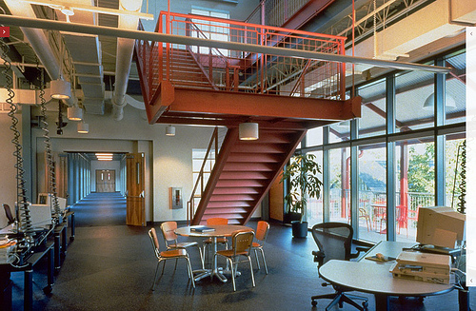
Adoption of flexible workplace design, mobility and other AWS strategies
Notes:
Adoption of flexible workplace design, mobility and other types of alternative workplace strategies (AWS) is now seen as the primary alternative to building new space

Slide 16
Immediate bottom - line impact by consolidating space
Notes:
CRE delivered immediate bottom line impact in the 2009 recession by consolidating space.

Slide 17
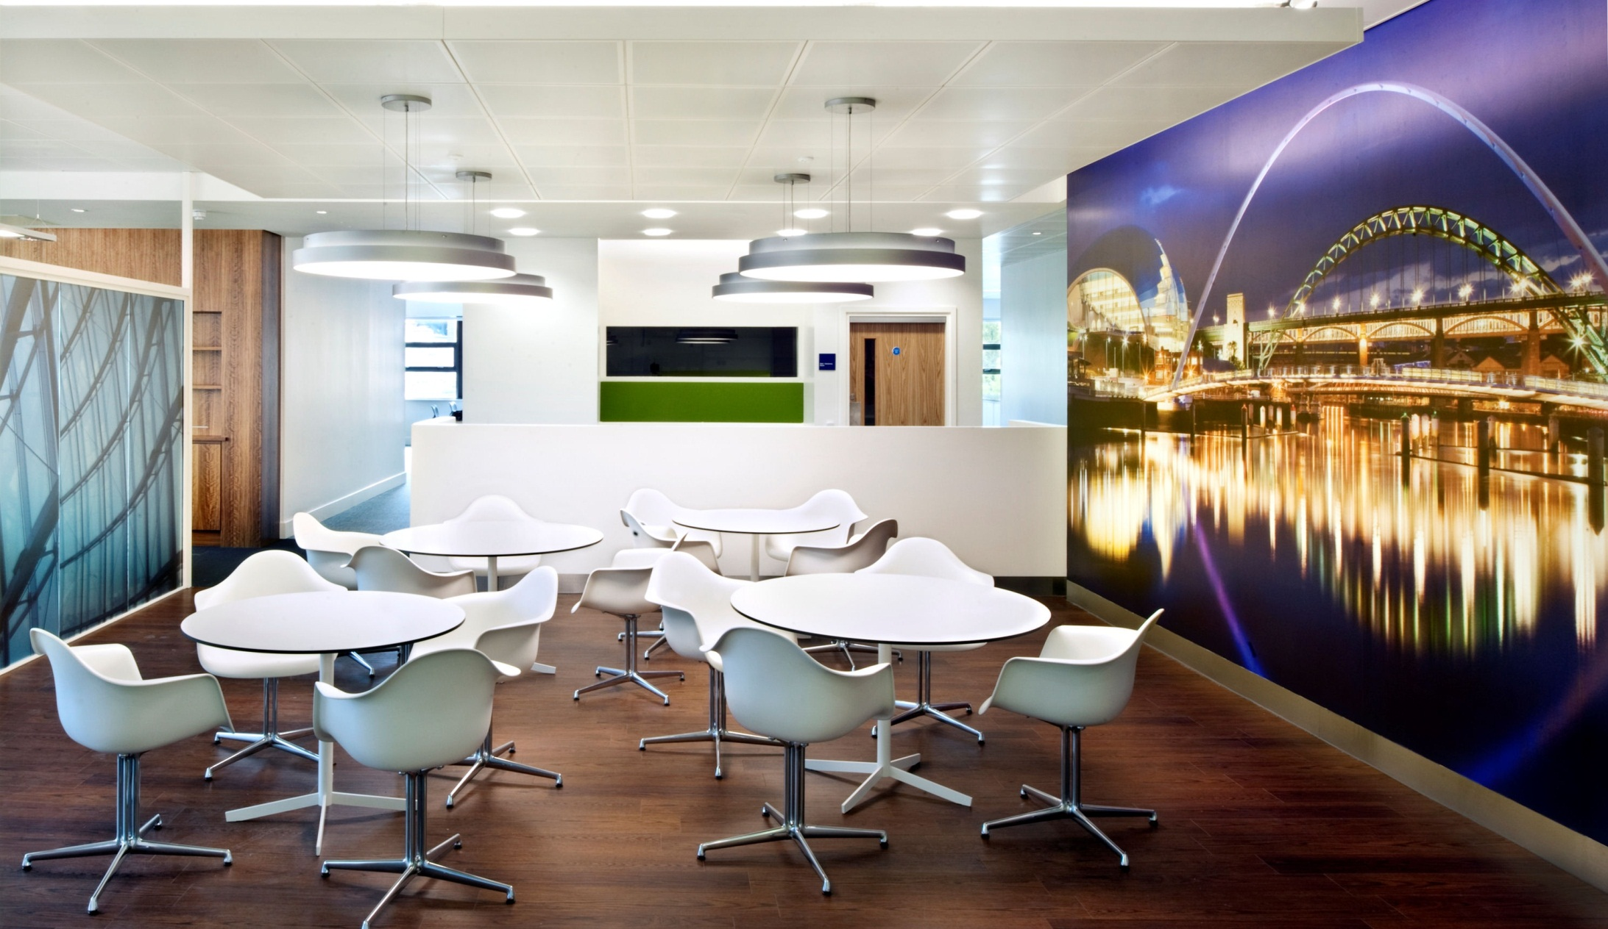
3. Workplace Team Key Findings
Notes:
The 2020 workplace team’s research findings (third on the list on slide 2)

Slide 18
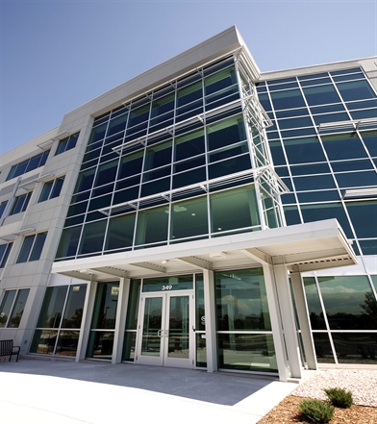
Presence in the traditional office will become significantly more abbreviated
Notes:
Office presence will become significantly more abbreviated, and office activities will become more intense and highly specific. The major driver of these dynamics will be extreme technology developments that will continue to impact the workplace.

Slide 19
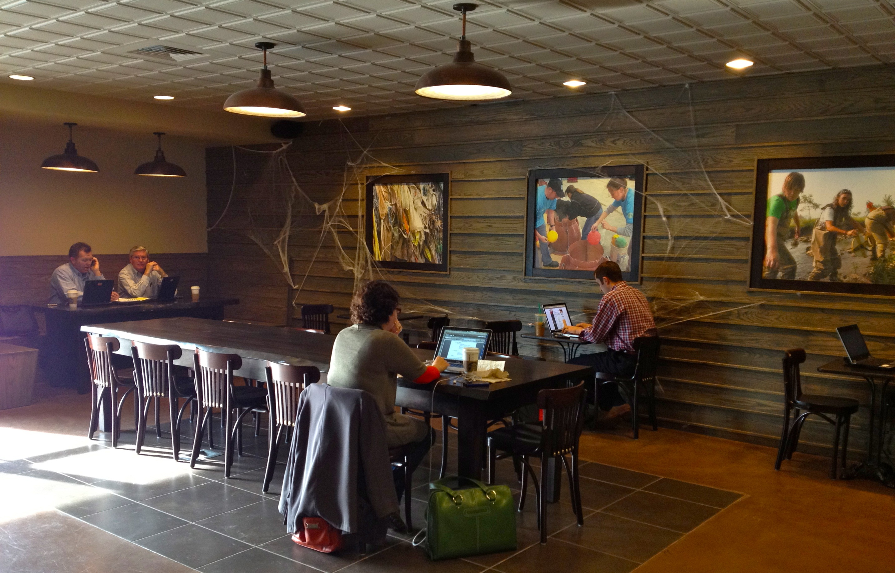
“Third places” describe a new breed of on-demand spaces away from the corporate office
Notes:
Corporations will turn to third places to provide on-demand models of office space and technology to serve the mobile worker and knowledge work as a whole. A ‘third place’ is any public space used as a remote office – a coffee shop, library, hotel, airport, etc.

Slide 20
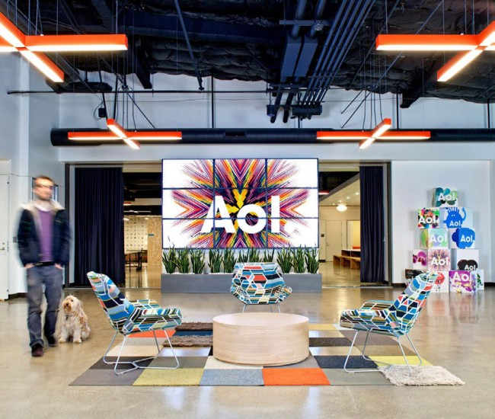
Integration of company branding with its workplace and people
Notes:
To create this type of integration between company and place requires the CRE executive to partner with other functional areas of the company.

Slide 21
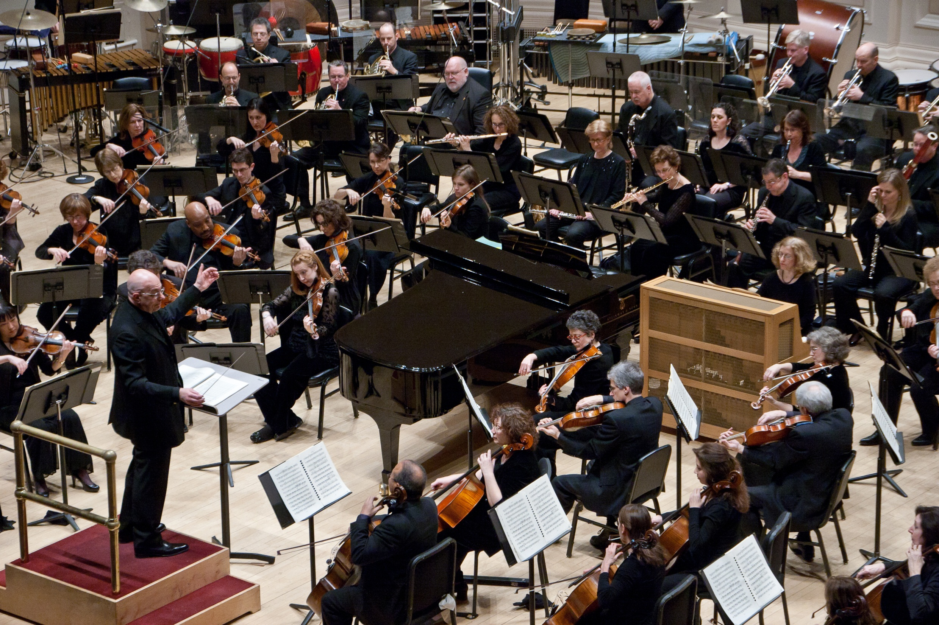
The workplace should be an environment that helps people perform
Notes:
the CRE leader will become an “Experience Manager,” offering employees “an à la carte workplace experience with a menu of services, locations and support,”
The CRE department will create spaces that maximize productivity and efficiency while offering enhanced services in the workplace.

Slide 22
Workers still value office time
Notes:
Knowledge workers will come in for a day, three hours or three days. They may require technology for meetings, need a place to unwind and refresh their creativity or seek a private space for calls.
People need a place to connect and learn. The office provides the tools and resources for both collaboration and heads down space. Additionally, the office supports team development and camaraderie.

Slide 23
Other Corporate Real Estate 2020 Domains’ Predictions Also Involve the Workplace
Notes:
In addition to the workplace team, other 2020 teams’ findings involve the workplace

Slide 24
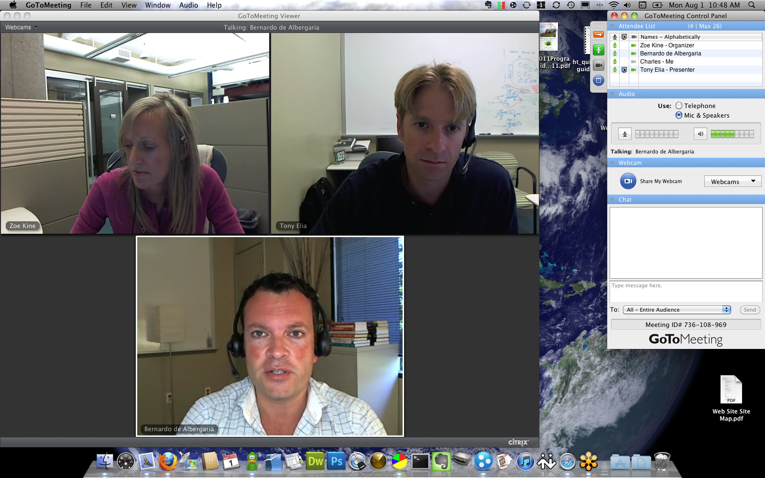
Video technology becomes more prevalent
Notes:
Video technology is going to continue to evolve and become more and more engrained in day to day office activities.

Slide 25
Technology advances support a fully wireless office
Notes:
Technology plays a key role in the workplace. Workplace transformation will be unsuccessful without the ability to provide interruption-free service from anywhere in the office.

Slide 26
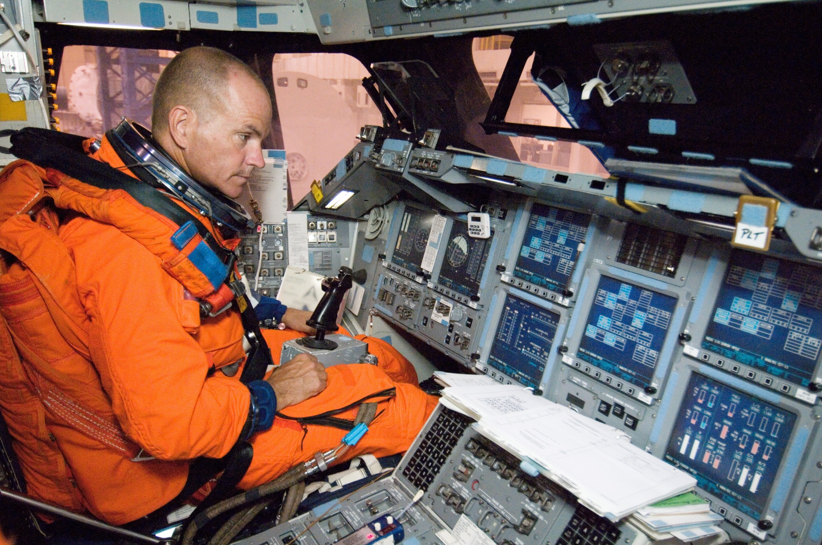
Real-time management of space availability, quality and energy
Notes:
The real time management of space availability, quality and energy consumption leads to to lower costs, increased communication and perceived value by occupants. This will maximize efficiency and reduce energy consumption

Slide 27
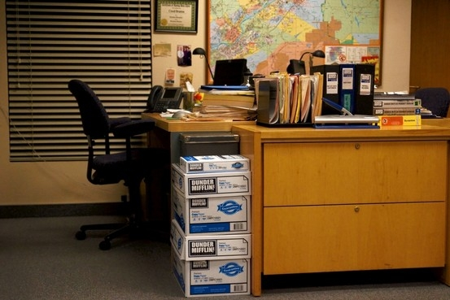
Workplace is crucial in creating and supporting corporate culture and change
Notes:
The workplace is crucial in creating and supporting corporate culture and change.

Slide 28
The connection between the work of the organization…

Slide 29
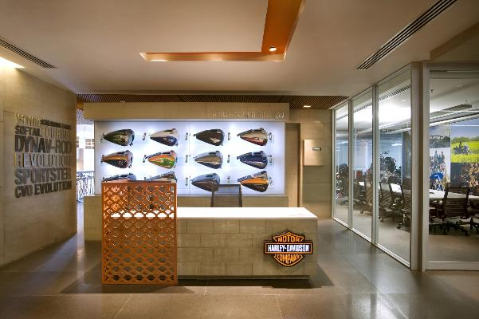
… and the workplace will continue
Notes:
This connection between the work of the organization and the workplace will inspire innovation and drive employee productivity

Slide 30
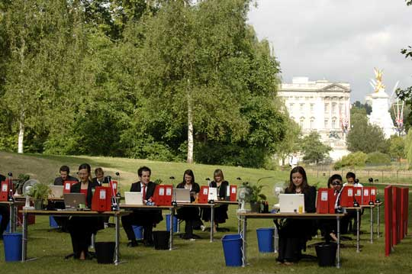
Alternative Workplace Strategies will Play a Role…

Slide 31
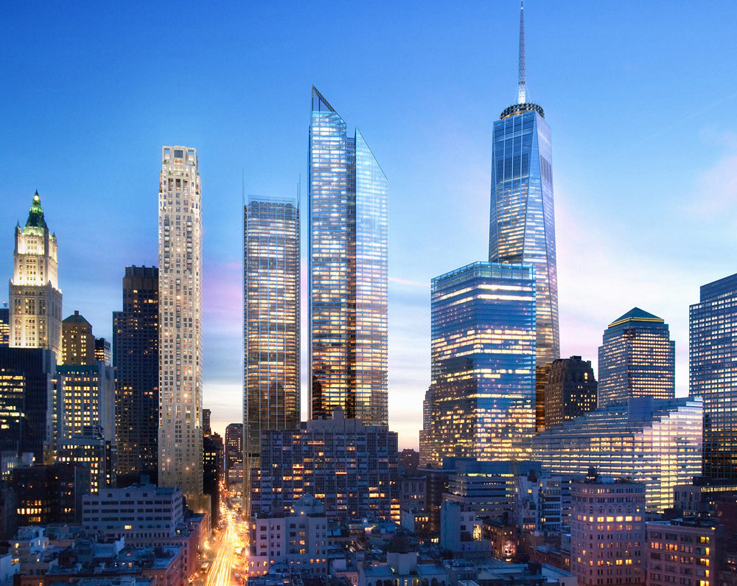
…but physical place will predominate
Notes:
The virtual office will play a larger role in some sectors than others, but physical place will predominate when we consider the totality of corporate real estate. The office will not go away in the future.

Slide 32
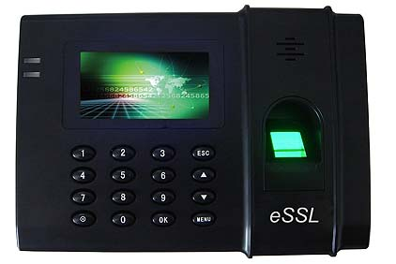
4. Technology has the Greatest Potential Impact on Workplace
Notes:
# 4 from list on slide 2.
This is a scanner used much like an access key-card, only it scans the employees thumbprint to grant access (this might be a helpful addition for the CNG office; we wouldn’t have to worry about losing the card). Not only does this device permit admittance to the office, it tracks employee hours and can be linked to the accounting system.

Slide 33
By 2020, the digital universe will be 44 times bigger than it is now
And 34% of it will be based in the cloud
Notes:
The digital world is only going to expand. The cloud offers a totally shareable space for storing data and working together from anywhere in the world

Slide 34
Bring your own technology (BYOT) continues an upward trend
BYOT
Notes:
Driven by consumer market constantly offering new technologies or adaptations, workers scan for “better’ and “easier” options, could potentially save company money and space

Slide 35
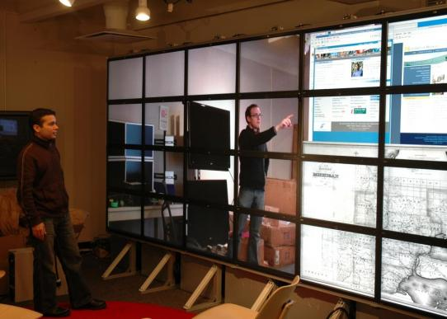
Technology enables the workplace
Notes:
Technology is the “glue” that holds the workplace together. Without it, efficiency and productivity would be lost. Because of the importance of technology in the workplace, it is essential to have IT involved very closely with CRE to support a workplace transformation that delivers superior space and a variety of places to work all without any interruptions in service. Wireless technology is a very important ingredient in workplace transformation.

Slide 36
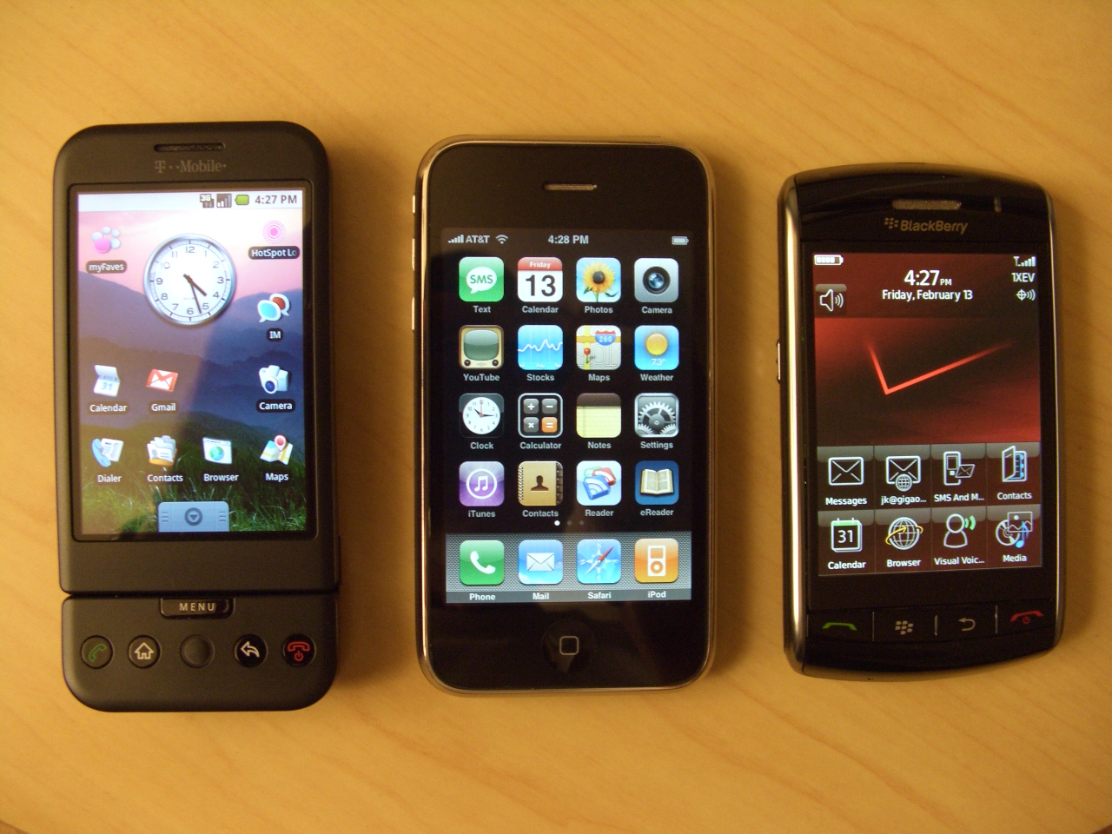
Smarter, more powerful hand-held Devices
Smart Devices
Enable mobile and flexible work
Notes:
This can be a good or a bad thing. The evolution of the hand-held device engendered the 24-hr workday. Always on and always connected can mean always working. Despite this, the hand-held device enables worker productivity and connectivity to the office.

Slide 37
Unified Communications have converged voice, video, data and graphics
Notes:
An example of this would be a phone system that allows you to receive your voice mail messages via email through and audio file.

Slide 38
5. CoreNet Global
Office Transformation
Notes:
(Angela, I know our office wasn’t quite this dated. I will find a new picture if you would like one – Melissa)

Slide 39
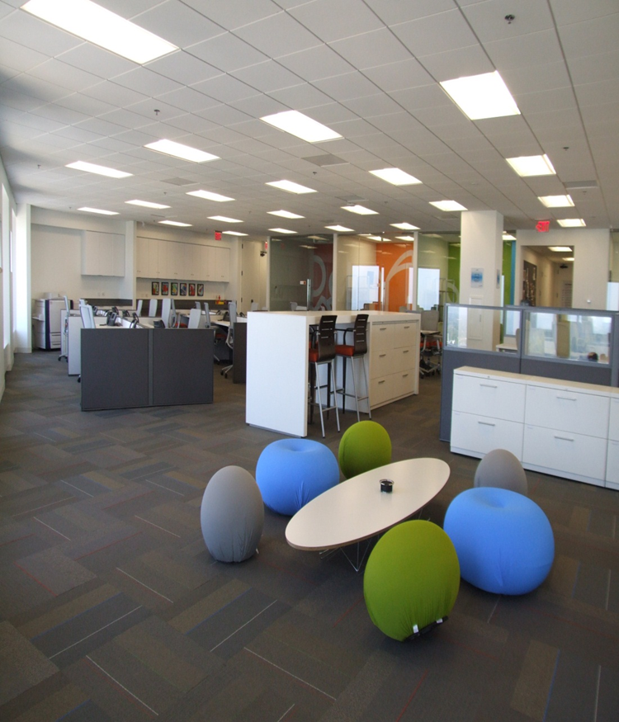
Total space cut by 20%
Nearly 100% unassigned space
Space per worker reduced from 315 to 261 square feet

Slide 40
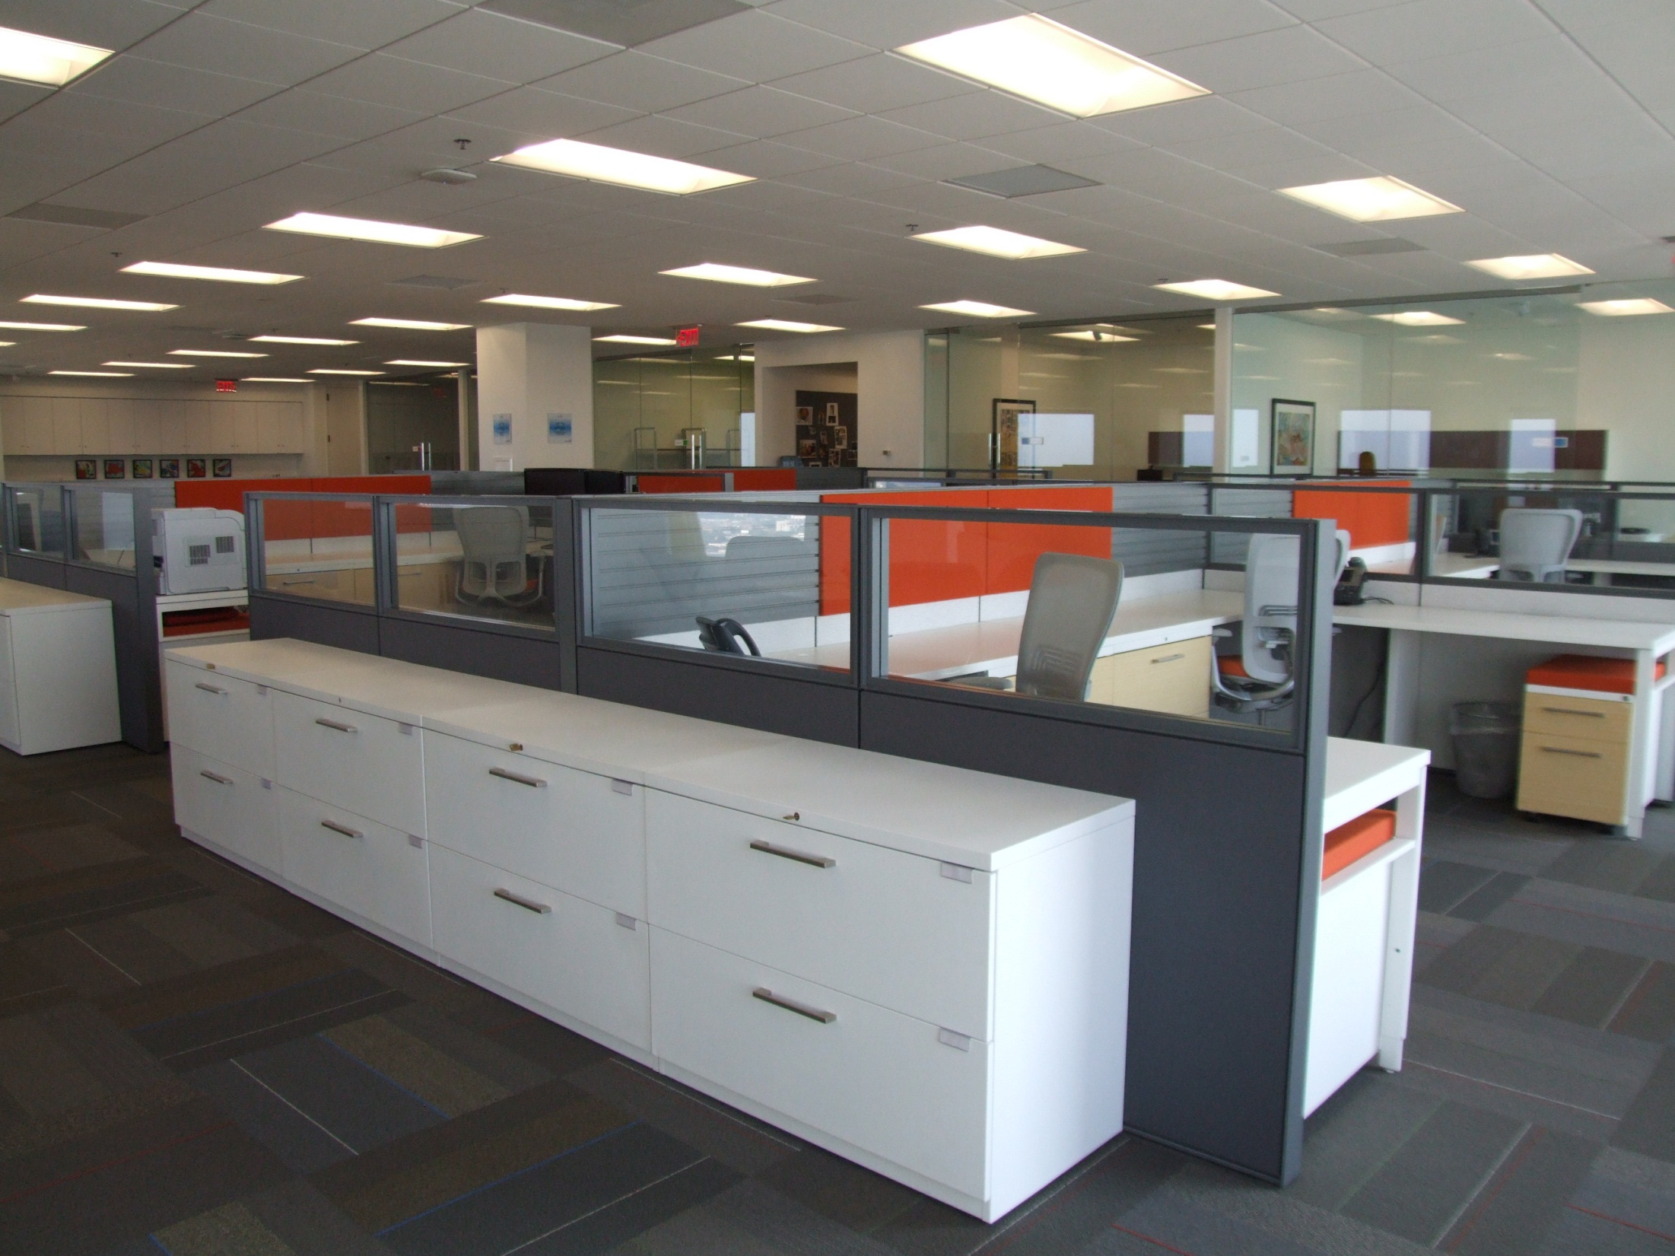
$36,000 annual reduction in Operating expenses
Base rent from $21/RSF to $19.50/RSF

Slide 41
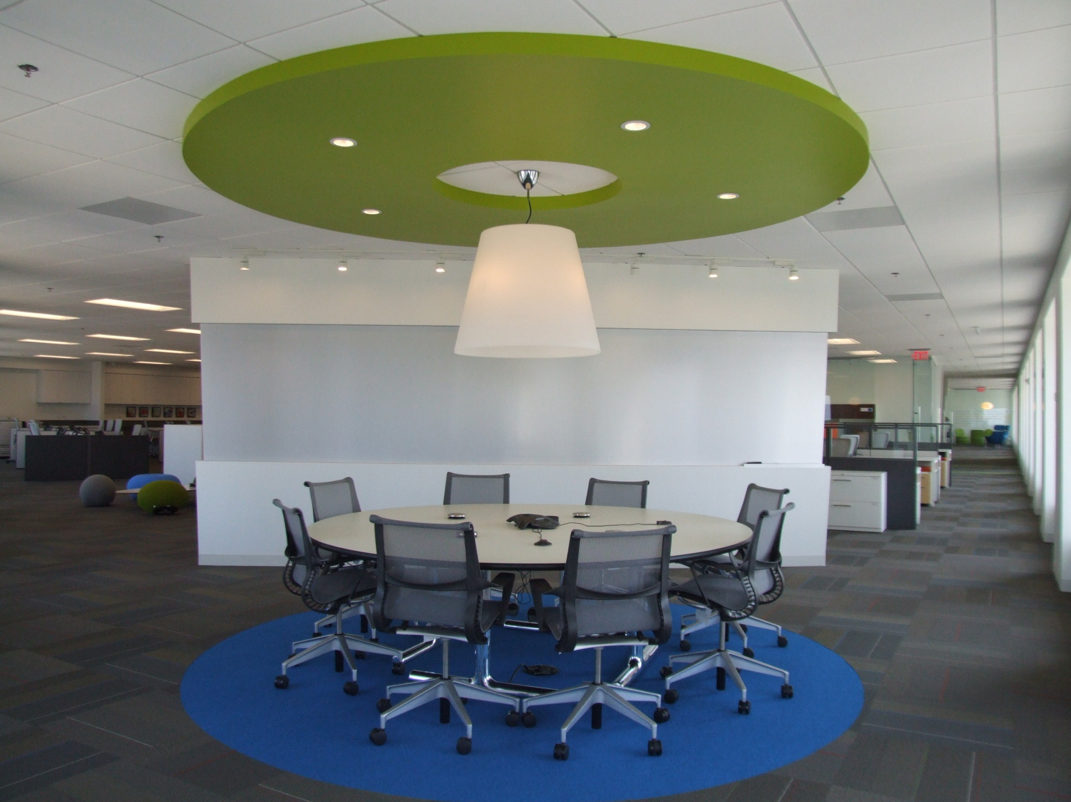
Use of repurposed construction, flooring and furnishing materials
Cash neutral lease

Slide 42
Virtual Office Tour
Notes:
The office tour will play in Slideshow mode

Slide 43
Staff testimonials

Slide 44
“I find that People talk more,
help each other more and connect more. “

Slide 45
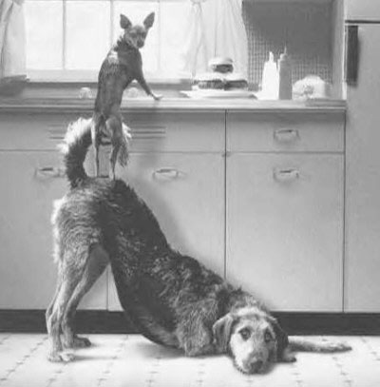
“Teamwork and camaraderie are way up!”

Slide 46
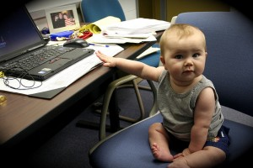
“I am much more productive in the new office!”

Slide 47
“now, our entire office feels like one big team.”

