Slide 1
Developing Your Potential with CoreNet Global

Slide 2
What Skills Do You Need?

Slide 3
How Can CoreNet Aid in You Professional Development
Connect with the Right Network
Multiple Learning Opportunities
Opportunity to Grow Professionally
Belonging Has Leadership Benefits

Slide 4
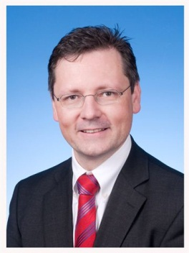
Connect with the Right Network
“This international network of corporate real estate experts
provides me with a cross-company view on corporate real
estate management as well as global industry trends. It also
helps me react to day-to-day challenges much faster.”
Thomas Glatte
Head of Global Real Estate
BASF
“CoreNet Global has been the primary medium through
which I have learned best practices and engaged my peers
in discussions of common problems over the past
10 – 15 years.”
Mark Schleyer
Senior Vice President
Corp. Real Estate
AT&T

Slide 5
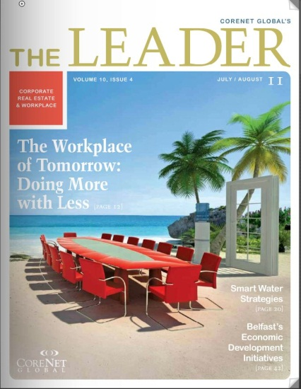
Learning Opportunities
Summits
Attend In Person
Attend Virtually – Summit Connect
Local & Regional Chapter Events
Communities of Practice
Workplace
Sustainability
Strategy & Portfolio Practice
Knowledge Center Online
Publications & Industry Information
Learning Series
MCR
SCLR

Slide 6
More Detail About Learning

Slide 7
Practical Learning - Immediate Results

Slide 8
Grow Professionally
Get recognized through one of CoreNet Global’s prestigious awards, including:
H. Bruce Russell Global Innovator’s Award
Economic Development Leadership Award
Sustainable Leadership Award for Design & Development
Industry Excellence Award
Become a mentor for those professionals who are new to the industry
Share knowledge and best practices to excel in your company and your industry

Slide 9
Belong
By bringing together all facets of the corporate real estate industry, CoreNet Global has become the association of choice. Join the network, get involved!
Serve on a chapter committee or task force, or become a chapter leader
Become active on the global Board of Directors or on global committees and task forces
Focus on a specific area of interest such as Workplace, Sustainability or Strategy & Portfolio Planning
Become involved with the Community Reinvestment Challenge (CRC)

Slide 10
Financial Advantages of Partnership
Discounted CoreNet Memberships
Discounted Summit Registration Fees
Level 4 Access to the Knowledge Center Online
Learning
Free Pass to Discovery Forums
Waiver of Candidacy Fee
Priority Admittance to Classes

Slide 11
QUESTIONS & ANSWERS

